Slide 1













NSCET HACKATHON 2024
Problem Statement ID -
Problem Statement Title -
Theme -
PS Category- Software/Hardware
Team ID -
Team Name (Registered on portal)

Slide 2



IDEA TITLE
Proposed Solution (Describe your Idea/Solution/Prototype)
Detailed explanation of the proposed solution
How it addresses the problem
Innovation and uniqueness of the solution

Slide 3


TECHNICAL APPROACH
Technologies to be used (e.g. programming languages, frameworks, hardware)
Methodology and process for implementation (Flow Charts/Images/ working prototype)

Slide 4







FEASIBILITY AND VIABILITY
Analysis of the feasibility of the idea
Potential challenges and risks
Strategies for overcoming these challenges

Slide 5





IMPACT AND BENEFITS
Potential impact on the target audience
Benefits of the solution (social, economic, environmental, etc.)

Slide 6










RESEARCH AND REFERENCES
Details / Links of the reference and research work

Slide 7
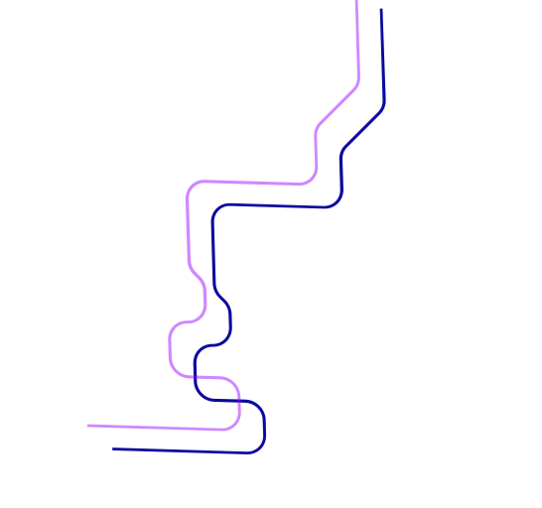



IMPORTANT INSTRUCTIONS
Slide Limit: The presentation must be limited to a maximum of six (6) slides, including the title slide.
Content Presentation: Avoid using paragraphs. Instead, present your idea using points, diagrams, infographics, or pictures.
Clarity and Precision: Keep your explanations brief, clear, and easy to understand.
Originality: Ensure your idea is unique and novel.
Template Usage: Use the provided template without altering the idea details pointers from the previous slides.
File Format: Save the final presentation as a PDF. Only PDF submissions will be accepted—no PPT, Word Doc, or other formats.
Guidelines for Submitting the Idea PPT (NSCET - Hackathon 2024)
Note: Remove this slide (Guidelines) before uploading your idea details to the NSCET HACKATHON 2024 portal.

